Slide 1
Workflow Mining:
Concepts and Algorithm
Dr. Boleslaw Mikolajczak

Slide 2
Contents
Workflows and Petri net-based Workflows
Workflow Mining – Concepts and Notations
Workflow Mining Algorithm
Example and Demonstration

Slide 3
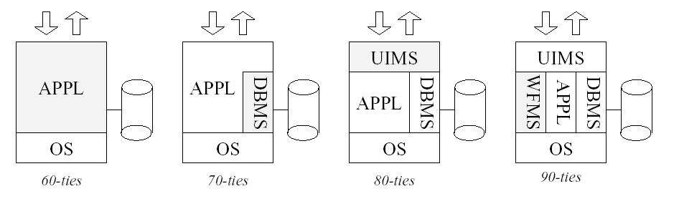
Introduction to Workflows
Workflow Flow Management Systems and Information Systems

Slide 4
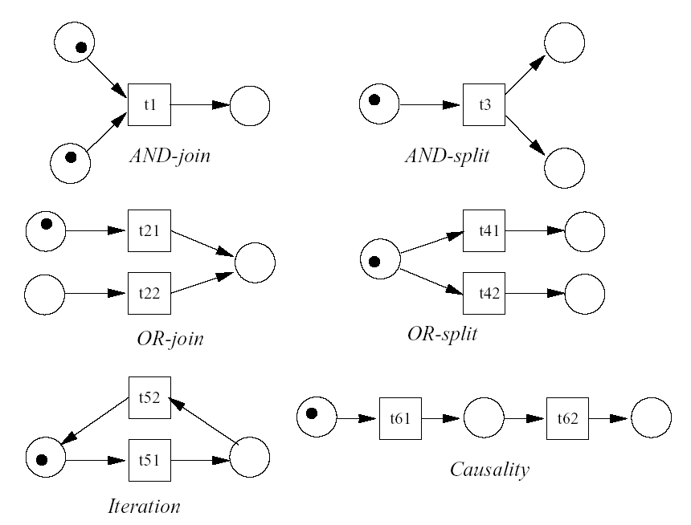
Introduction to Workflows with
Petri Nets
Reason 1: Formal semantics and graphical representation

Slide 5
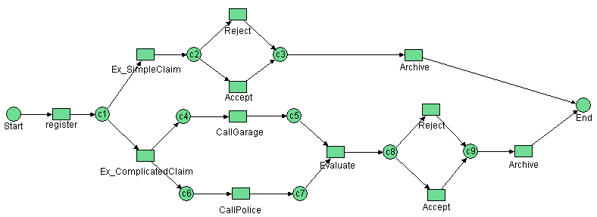
Introduction to Workflows with
Petri Nets
Reason 2: State-based AND event-based
  In modern modeling technology, like UML, tasks are modeled explicitly and states between subsequent tasks are suppressed, so the enabling of a task and the execution of tasks can not be distinguished clearly.

Slide 6
Introduction to Workflows with
Petri Nets
Reason 3: Abundance of analysis and V/V techniques
  Petri nets are marked by the availability of many analysis techniques. Clearly, this is a great asset in favor of a Petri-net-based WFMS. In general, these techniques can be used to prove properties (safety properties, invariance properties, deadlock, etc.) and to calculate performance measures (response times, waiting times, occupation rates, etc.). These techniques enable users to analyze a workflow process in various ways (including simulation).

Slide 7
Definition of Workflow Mining
Workflow design is a complicated time-consuming process and typically there are discrepancies between the actual workflow processes and the processes that are perceived by the management. To support the (re)-design of workflows, we need some techniques for discovering workflow models. We use “workflow-log” containing dynamic information about the workflow process as it is actually being executed, to do the workflow mining.
Workflow mining = Workflow identification algorithms

Slide 8
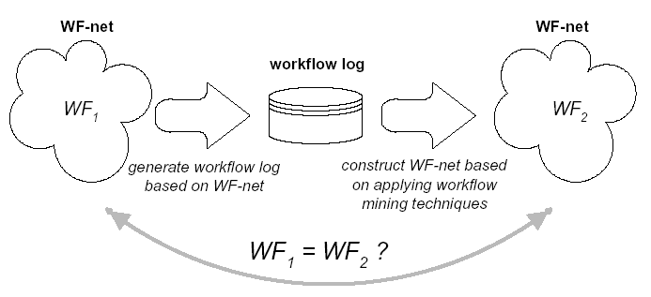
Definition of Workflow Mining

Slide 9
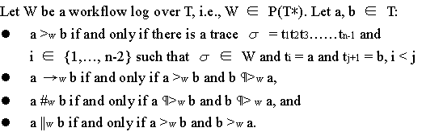
Algorithm of Workflow Mining
Log-based ordering relations:

Slide 10
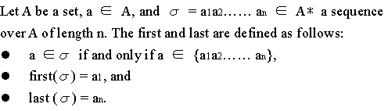
Algorithm of Workflow Mining
Definition of first() and last():

Slide 11
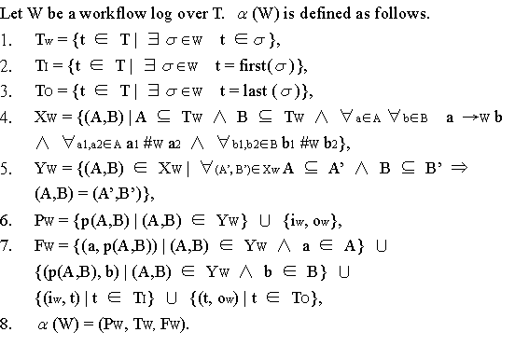
Algorithm of Workflow Mining
Alpha-mining algorithm:

